Slide 1
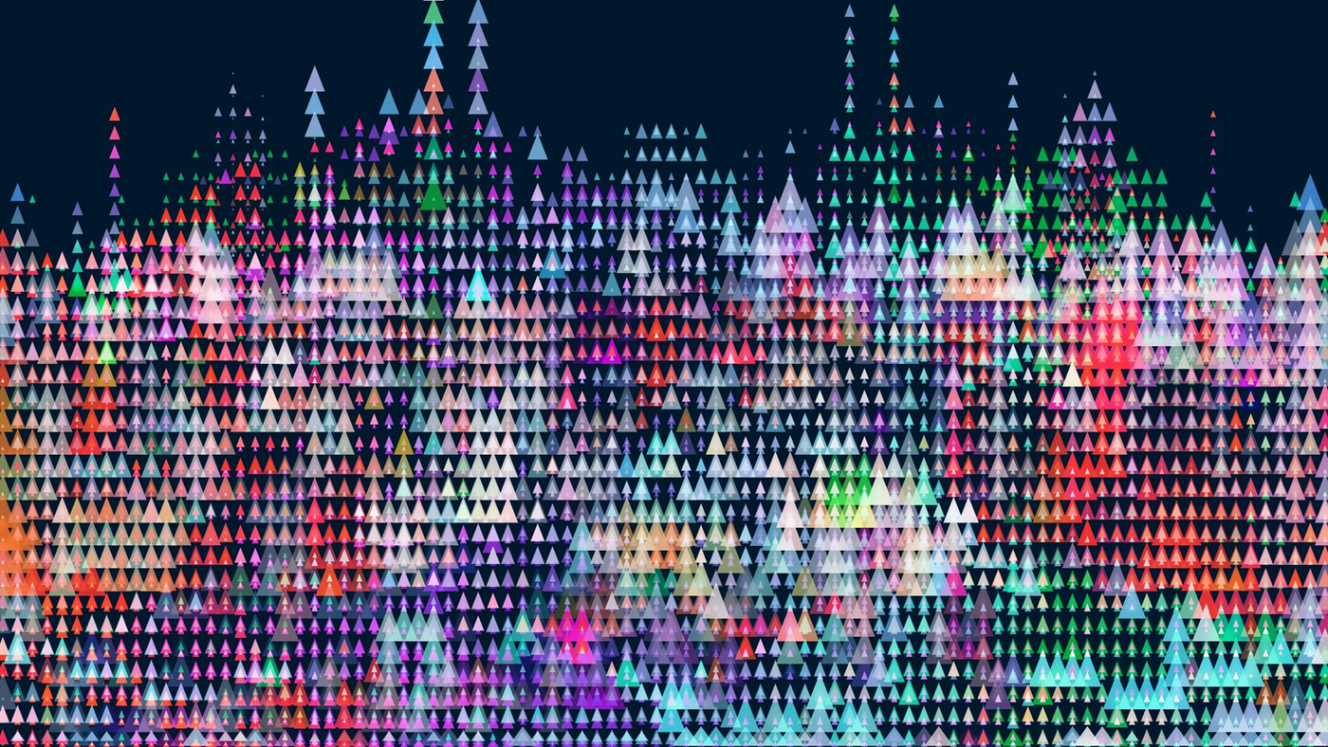


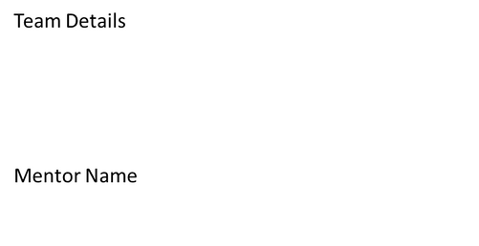
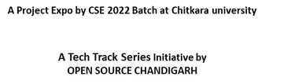
Aadit Wadhwa - 2210990002
Aakash Jain - 2210990008
Aarav Shourie - 2210990010
Ms. Rajwinder Kaur

Slide 2
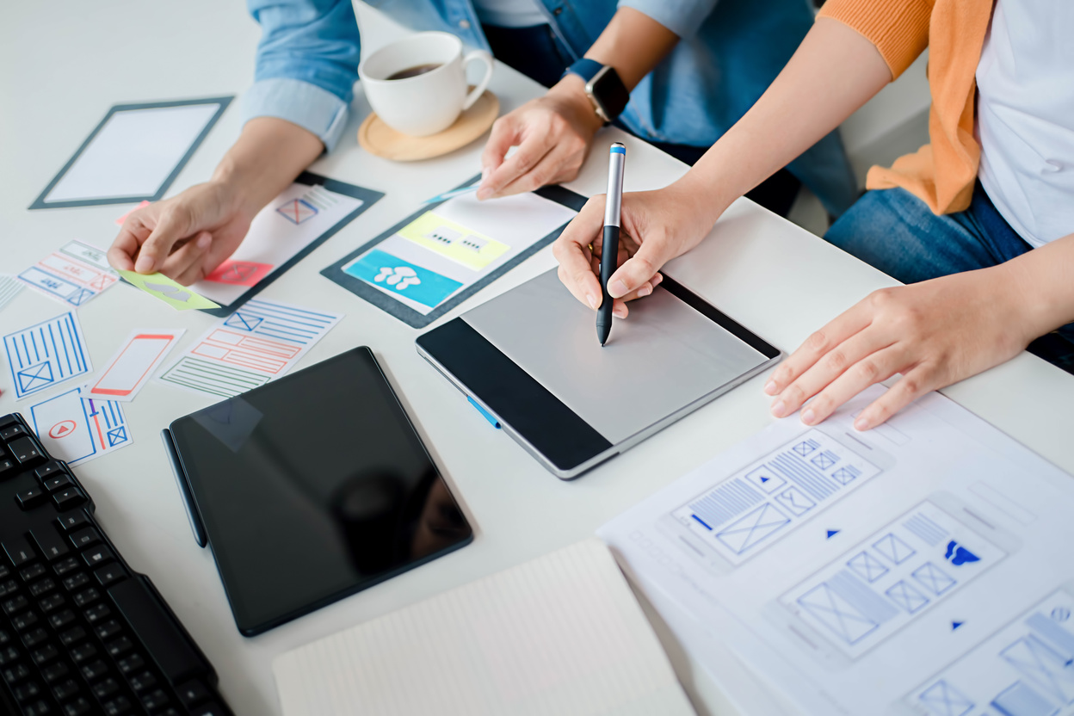
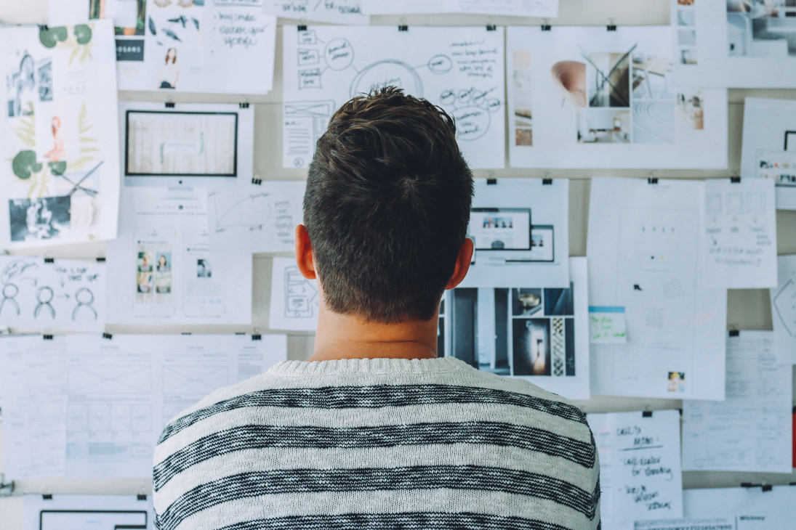
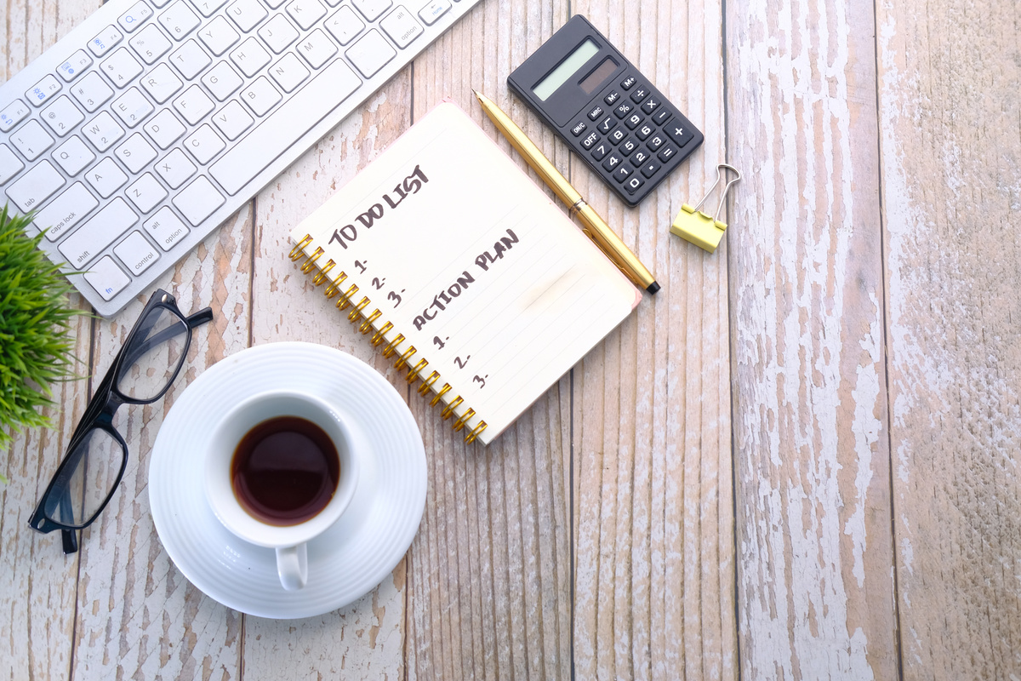
Everything you need to make your life productive.
Struggling with organizing your daily chores?
Ready to level up your daily routine with us?
Introducing an application that allows individual to create task reminders. Due to the fact that there are too many tasks, it can be easier for people to arrange their assignments according to the day and time they have been specified.
Introduction

Slide 3
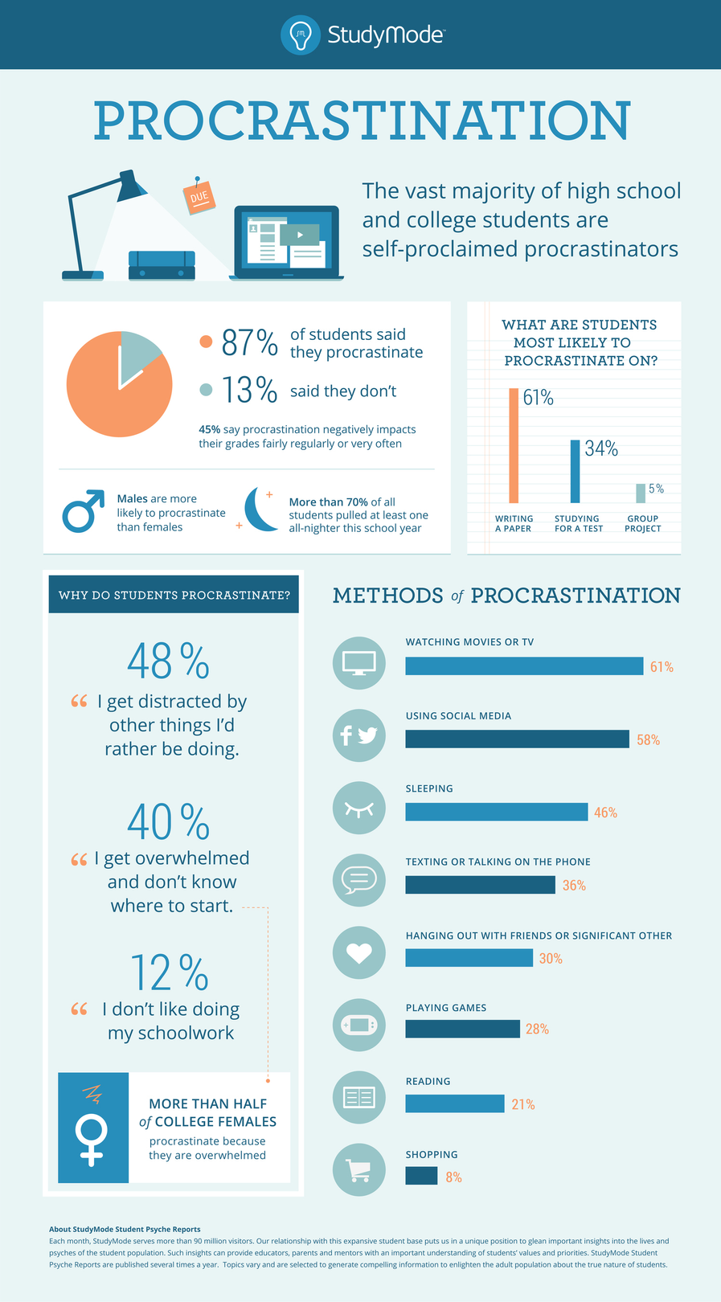
Is it difficult to remember every task and time with details?
Do you think of buying chocolate but forget to take it because you had a long list of grocery items to buy?
Don't worry,
We have a sloution!

Slide 4
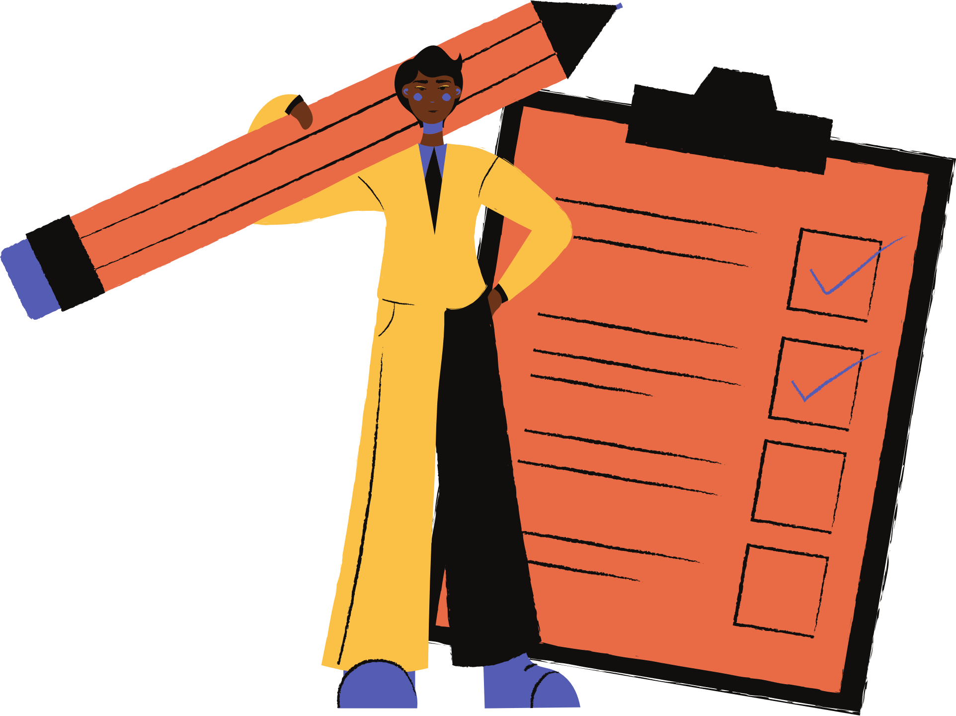
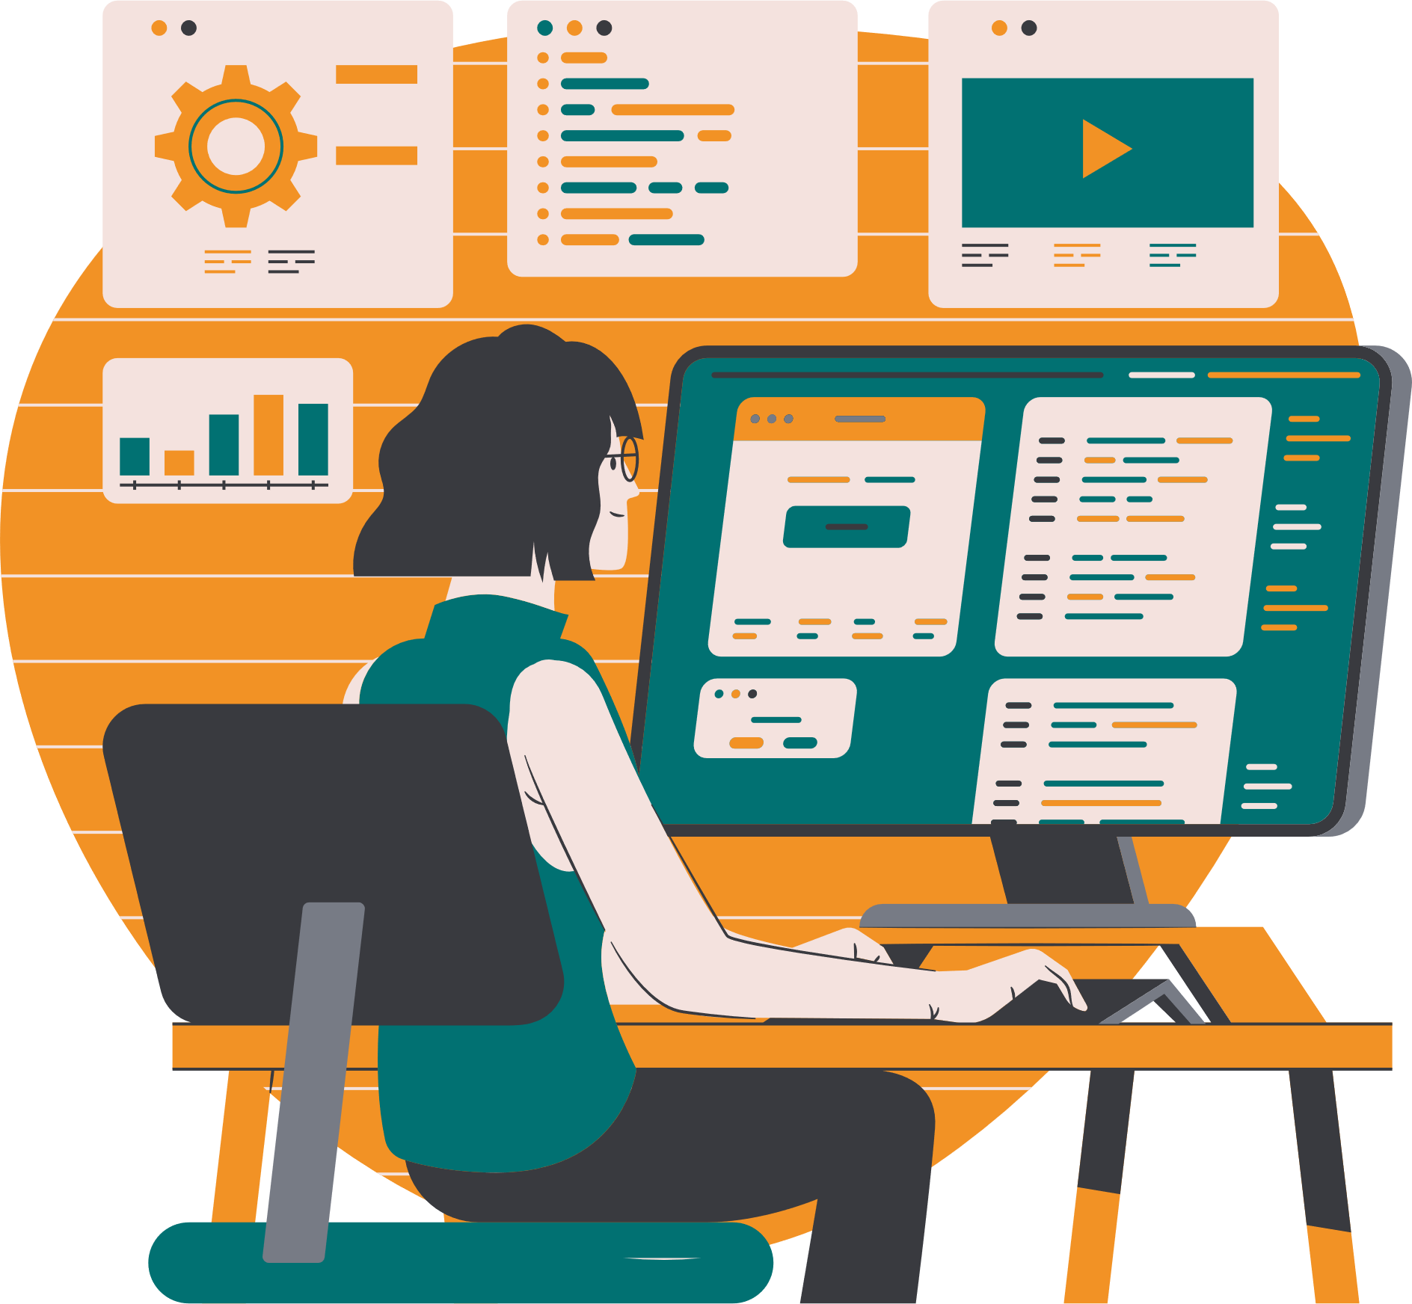
OBJECTIVE
To help users organize their whole day and make it productive.
To implement a reminder notifications like subscription alerts, assignment submission deadlines and much more.
To help students in terms of keeping time and be more efficient.
To let users focus on one task at a time and let us worry about reminding your further tasks.

Slide 5
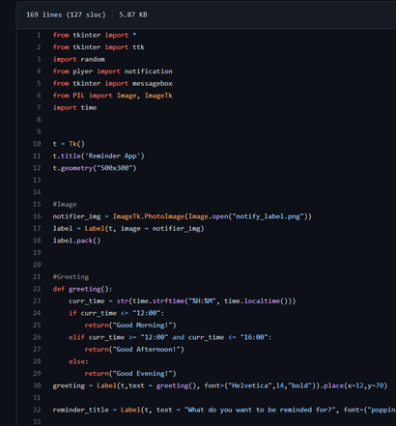

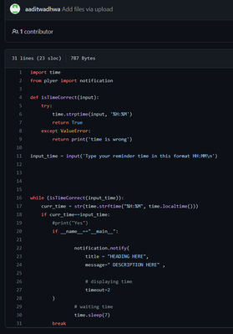
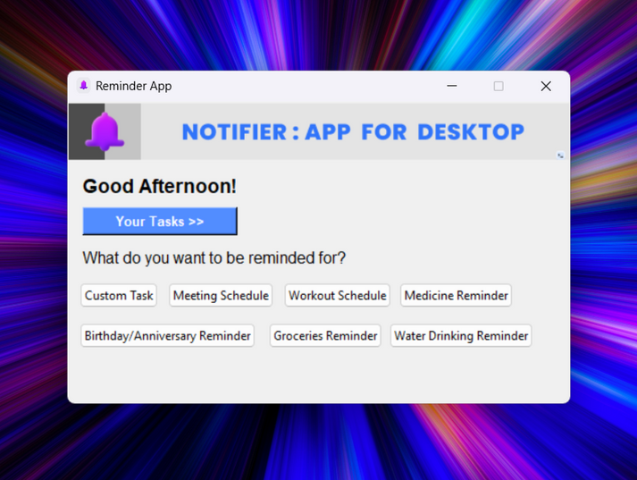

Platform Design
Implementation
Software Development
Reminder app starts with multiple labels where user can select any of these categories and set reminder accordingly.
User Feedback

Slide 6

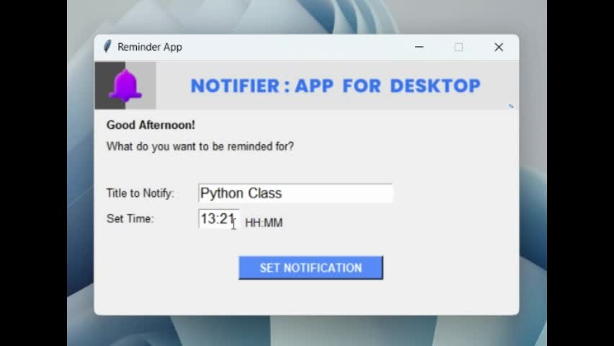
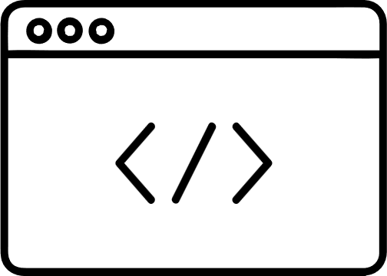
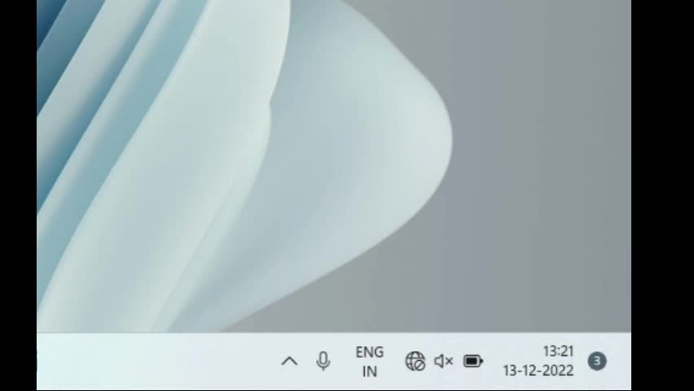
Result

Slide 7




Created user-friendly labels
Home Page

Slide 8

FUTURE
WORK
1
SUGGESTING TASKS
Turning boredom into productivity in your free time.
2
ROADMAP FOR PERSONAL DEVELOPMENT OR STUDENT EXCLUSIVE
SCOPE OF OUR PROJECT
3
COMPATABILITY
Building cloud based mobile app to keep in sync with all your devices including gaming consoles and TV.
4
PRODUCTIVITY
Introducing POMODORO Technique for developing concentration.
5
USER FRIENDLY UI
Adding animations and using different stack.

Slide 9
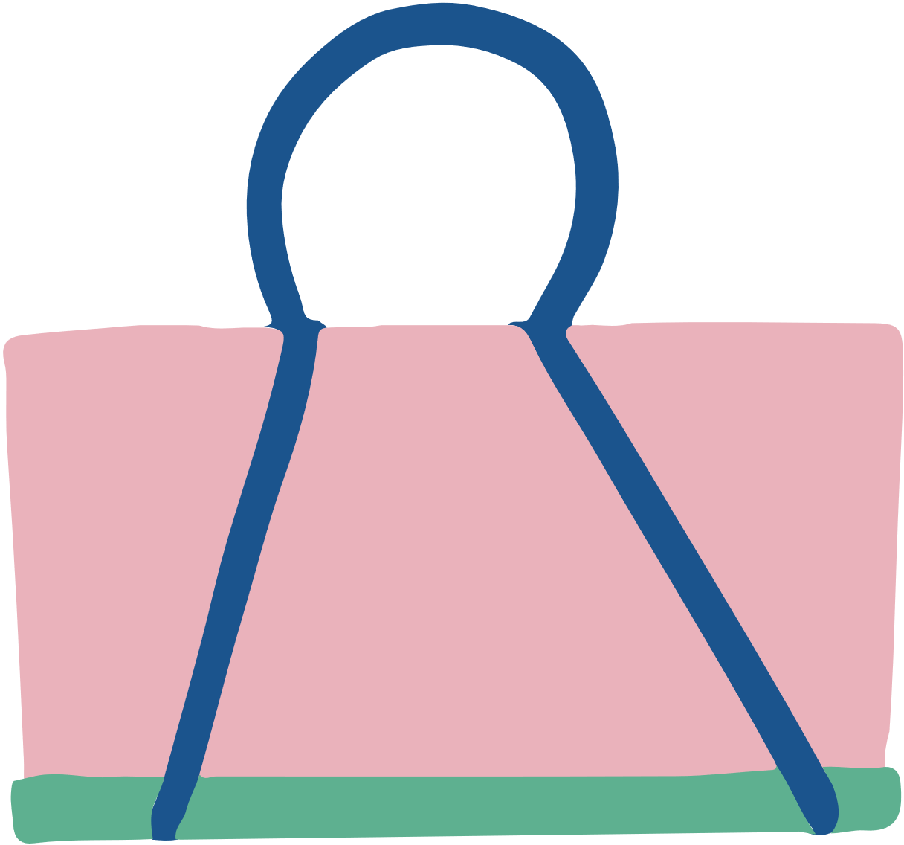









Added greeting which checks current time and wishes accordingly.
Created a list of motivational quotes and imported random to send you daily dose of motivation along with reminders.
</> code features
Used
python GUI tkinter
library
for UI.
built modules and functions for better organisation
imported notification library.

Slide 10










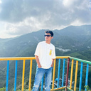
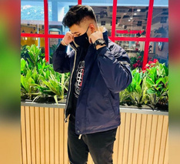
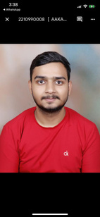
References
Thank You
Developed By:
Aadit Wadhwa
Aarav Shourie
reallygreatsite.com
Aakash Jain

